Slide 1
Today – real Neural Networks!
Basics of pytorch neural networks:
Creating models
Adding layers
Basic optimization options – early stopping, dropout, regularization. We’ll tune more next time.
Need to do some exercises and try it out…
Versioning and PyTorch notes:
I’ll do most of the work in Colab – so what you’ll get is identical.
If running on your computer, details may vary (largely around name/imports)

Slide 2
Neural Networks with PyTorch

Slide 3
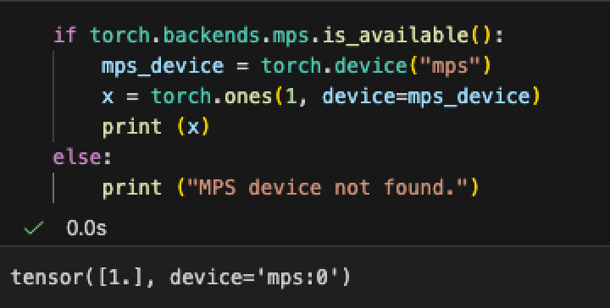
Where to run things
We can control where things are processed directly – GPU or CPU.
If you have a GPU, you want to set this up locally.
There a pip command for a GPU accelerated pytorch install.
Mine is an Apple M2, this shows that it’ll use the GPU.
It can be much, much faster.
We can manually send things to GPU as desired.
Generally, the batch that we are using.

Slide 4
Neural Network Libraries
Neural networks have libraries similar to sklearn, but there are some new concerns.
GPU acceleration – the big matrix math that is needed in neural networks is done much (much, much…) faster by GPUs (video cards) than by CPUs (regular processors).
To do any serious neural network training, we need a GPU of some sort.
nVidia GPUs are the king, and far beyond anything else, largely due to CUDA (next).
Apple silicon macs have tensorflow acceleration that you can enable.
Colab (or other online workbooks) offer GPU access, Colab is the easiest/cheapest solution.
Other GPUs like Radeons or Intel usually have something, but it tends to suck.
You typically install some variation of TensorFlow and get GPU friendly output.
The GPU operations utilize some faster set of commands than ‘normal’ operations. (CUDA)

Slide 5
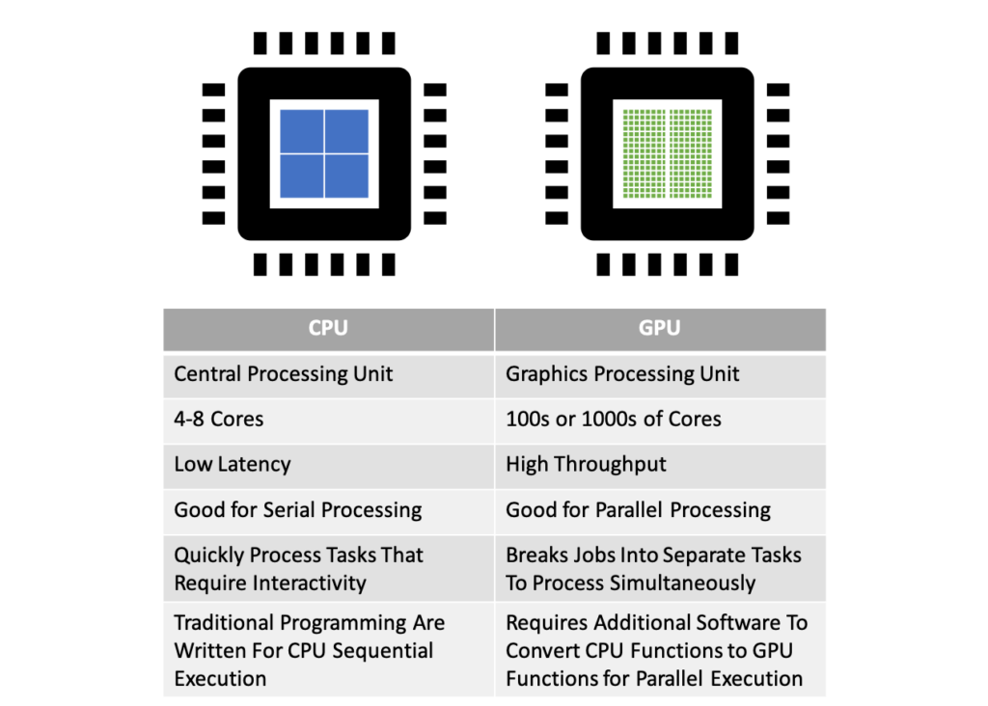
GPWho?
GPUs are graphical processors – video card.
Really good at 3d video.
Also really good at machine learning.
GPUs are good at many parallel calculations.
In graphics, things like objects, interactions, light, shading, position, etc…
In neural networks, these are all the matrix and gradient calculations that we do.
For ‘real’ NN we need to use GPUs (or equiv)

Slide 6
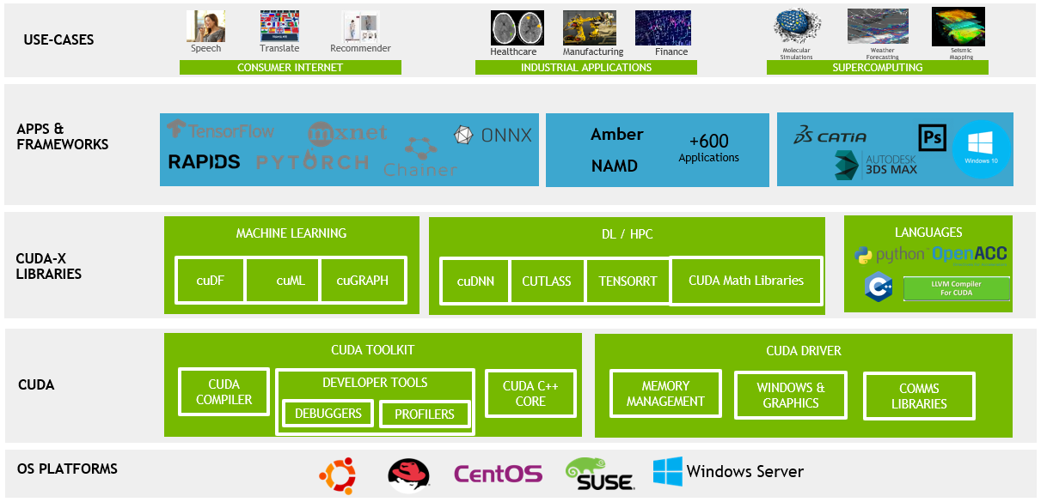

Slide 7
If this is something you want to do, what Hardware do you want?
The best overall solution (IMO) is a macbook pro/air + Colab or similar for big stuff.
Macbooks are accelerated enough for (most) trials, then you can use cloud for training.
Another GPU + Colab will probably work, thought support may vary.
If you want to train lots of stuff from scratch, get an nVidia GPU.
Look up speeds, there’s tensorflow/pytorch benchmark pages out there.
There’s no (effective) replacement for CUDA, so even fast hardware tends to lose out.
If you’re doing lots of stuff, having your own might be cheaper (though I’d hesitate unless you want the GPU for other stuff too, Colab is really fast, and upgrades things.)
There are hard limits for running models – they must fit in GPU memory.
Laptop GPUs will work but are much slower, so unless you want it to game, it isn’t worth it.
There are colab competitors out there, some give free time, some cost less, etc…

Slide 8
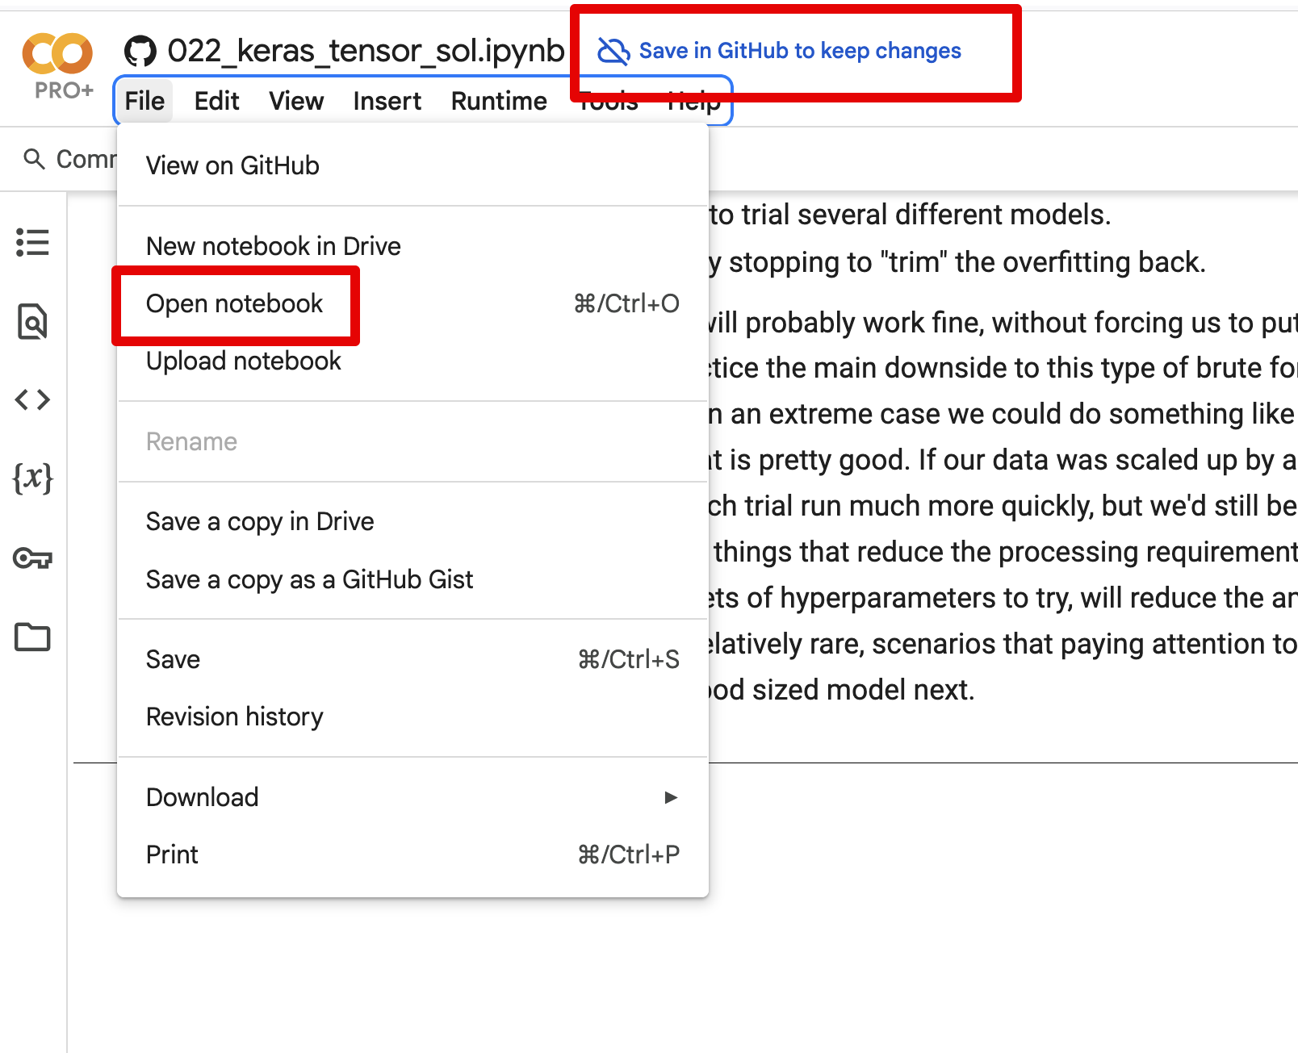
Coding in Colab
For me (and I assume most) we can use Colab for the NN stuff.
We can use things from GitHub and VSCode relatively easily.
I generally prefer to:
Code and run small tests locally. (Ifs for ‘in colab’ may help).
Push to my repository.
Open in Colab and run for real.
On Colab, use GPU runtimes for speed.
Acceleration – runtime -> change runtime type for GPU.
For now, what they give free is fine.

Slide 9

What is PyTorch?
Pytorch is a library that provides neural network models and tools.
Similar to how we use sklearn for statistical models.
Made by Facebook, in Zuckerberg’s pre-alpha bro, skinny and weak nerd, stage. Thanks Zuck!
There was a brief moment in time where big tech maybe, kinda did some good things on occasion.
Provides prebuilt functionality to do the majority of neural networks.
We don’t need to manually do matrix math and similar details.
We can focus on layers, loss, etc… at a higher level.

Slide 10
Neural Network Libraries
PyTorch is currently one of the two big NN libraries, with tensorflow/keras.
They do basically the same thing, syntax and details are different.
PyTorch tends to be more common on new/public stuff, tf is older and kind of more est.
There’s some messy and confusing stuff with backends, combining keras/torch, etc…
Ignore all this, unless you really care, it doesn’t matter much for learning.

Slide 11
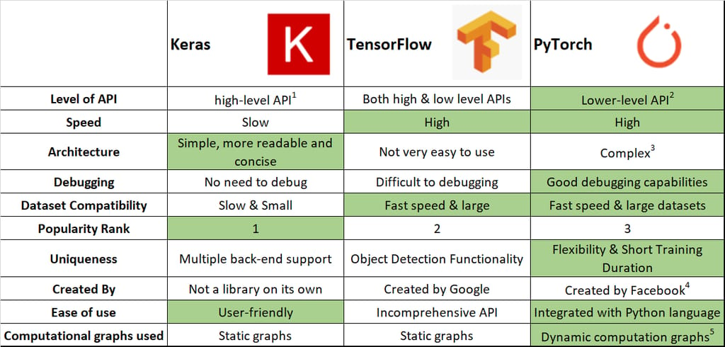

Slide 12
Our Usage…
PyTorch is much easier to use than doing it by hand, but not the simplest.
There’s still some boilerplate code and some details we need to manage.
Our main projects when making pytorch models will be:
Mange the data – similar to before, though now we make special torch specific data objects.
Construct the model – make a model object with the layers and such.
Configure training – define loss and optimization (gd algorithm).
Make train/test loops – define what happens when we train (similar to manual version).
The data and model are scenario specific, the loops are pretty boilerplate.
Note: there’s a condensed/simplified interface called lightning, we might touch it later.

Slide 13
Support and Resources
Generally, these models will have more custom code than sklearn projects.
#1 hint – build/test incrementally. Can I load one record, one set of records, train a model, test it, add layers, change optimizer, etc… Test one thing at a time if struggling.
The documentation is very substantial and mostly good.
PyTorch documentation is decent and has some examples.
The text gives pretty good explanations and examples that can be adapted.
There is a near infinite amount of resources and examples online – beware of version used.
I find it is easy to find answers, but you need to know what specifically you’re looking for.
E.g. “this model doesn’t work” is hard to answer, “this model gives this error when adding an LSTM layer” is probably pretty simple.

Slide 14
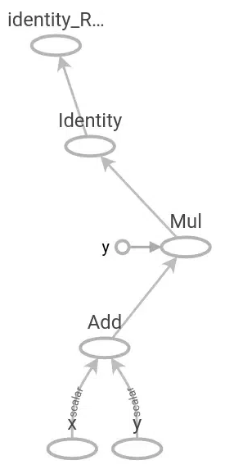
Introduction to Tensorflow
Just like sklearn provides a library of predictive models, tensorflow does similar for NN.
Tensorflow was developed by Google in 2015, it is free and open source.
Uses a graph internally to store the structure of a network.
Provides layers, loss functions, etc… allowing us to make NNs without coding the innards.
Calculations are offloaded to C++ modules, which are faster.
TensorFlow basically allows you to not do all the math by hand in making a neural network.
TensorFlow is still relatively low level (kind of like C vs Python).

Slide 15
Enter Keras…
Keras is an even higher-level library that provides an easier API for TF.
It’s pretty much all Keras now, at least as far as the labeling.
Originally a separate product, now integrated with the core of TF.
Keras can be used with other backends like pytorch.
The good:
Using Keras is relatively easy.
The bad:
Many things may have different names or convetions depending where they originated.
Everything that has changed names since I made this, and made me hate myself.
If you need to look something up, Google “Keras my_thing” and you’ll probably find it.
We don’t really need to differentiate between TF/Keras most (all??) of the time.

Slide 17
Getting’ Torchy With it
It is kind of lower-level in code syntax:
It looks ‘messier’ or more in the details that we might be used to.
In code, we need to:
Prepare data.
Create model structure.
Define the training loop.
Most of the details (gradient, loss) can be handled by pytorch, we must setup ‘framework’.

Slide 18

Using Keras and Tensorflow
When creating a NN with TF we don’t need to care about internal calculations.
We specify what the model is, what the layers are, and configure them via parameters.
Dot products and transposes can be ignored.
Starting point is creating a model, we’ll always use a Sequential one.
Other types of models allow for us to customize that internal stuff.

Slide 19

Please Cry for Me!
They seriously made the naming conventions and documentation with keras/tf so confusing…

Slide 20
Keras Documentation
The keras documentation is at https://keras.io/api/
It is generally pretty good and reasonably clear.
There are some pretty good examples for many things.
It also has slightly older documentation from TensorFlow.
This also comes up a lot if googling.
Lots of this stuff is very good, especially for more basic problems (like ours).
In general, the older stuff works the same, with minor changes:
Import and naming of stuff tends to change, function doesn’t.
Some things get superseded, but that is less common than name/place changes.

Slide 21
Pytorch Documentation
Pytorch is very widely used and is documented in many ways all over the internet.
The pytorch documentation is pretty good, has some tutorials and examples.

Slide 22
Creating a PyTorch Model
To make a model we need to do a bit more work than sklearn:
Create the model object, with the layers and structure defined.
Create datasets from the data or location of data on disk/db/network.
Define the configuration – loss and optimizer.
Define the loops – what to do each training and testing round.
Running it all!
Datasets and preprocessing is also quite different here.
Data is often/usually too big for memory.
Data loaders will manage pulling data off disk as needed.
Pipeline steps to preprocess data are normally applied to the data loader.

Slide 23
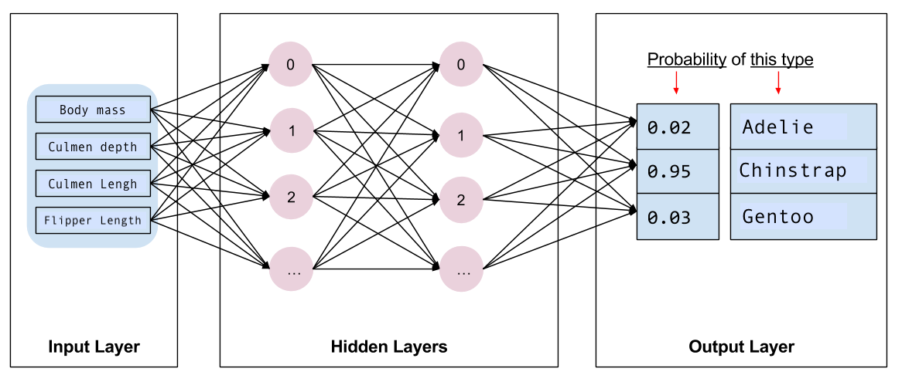
Pytorch Model Structure
The network itself is made of layers.
There are many types (later).
Layers types are premade*.
Input – handle data in its original shape.
Hidden – do the learning.
Output – translate learned values to prediction.
There are assorted other layers - normalization, reshaping, etc…

Slide 24
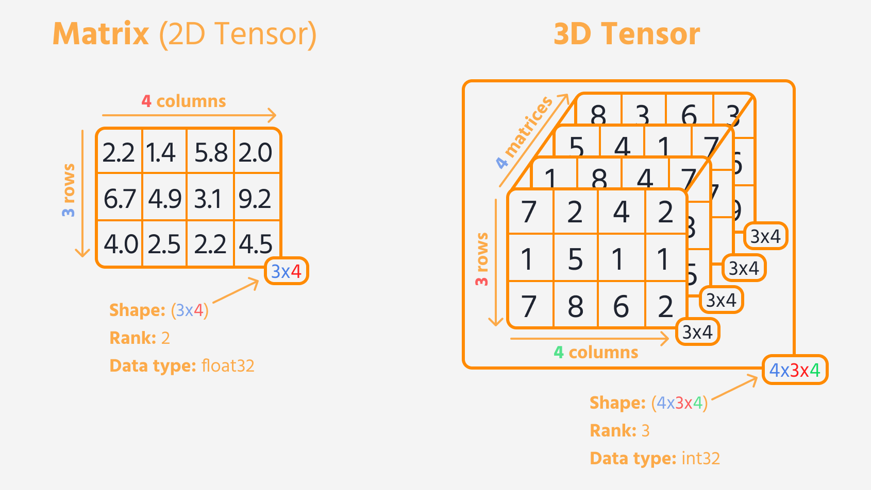
Dealing with Data
Data, when fed to the model, needs to be in a tensor.
A tensor is a 3+ dimension array.
This structure is part of what lets neural networks be good at unstructured stuff.
We can capture 3 or 4D data (images, video, etc…) in its ‘actual’ shape.
We can have very complex (high dimensional) representations of meaning.

Slide 25
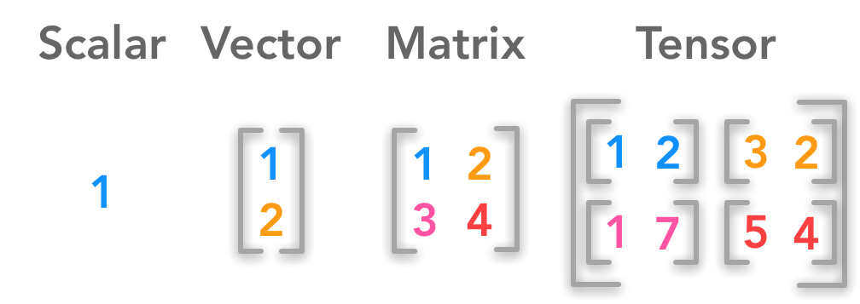
Tensors and Input Layer
Data can be in multiple dimensions.
The input layer defines the shape to expect.
For now, we’ll use something like (18,) which means just flat 18 features.
Later, like with images, we’ll specify the shape of each image, and the batch size in here.

Slide 26
Data Prep Pipes and Neural Nets
We can theoretically use/make a layer for most things that a pipeline does.
Encode, normalize, scale, etc…
Where and how this is actually done varies.
In simple examples, it is all over the place, often ad-hoc.
We can, later, create datasets that can manage large data and process steps.
These can handle large amounts of data easily – out of memory data.
We can plan for processing times to maximize resource utilization.
Tl;dr – we don’t care much about preprocessing details now, it’ll change with datasets.
You need to do it, just pick a spot – usually just before the modelling part.

Slide 27
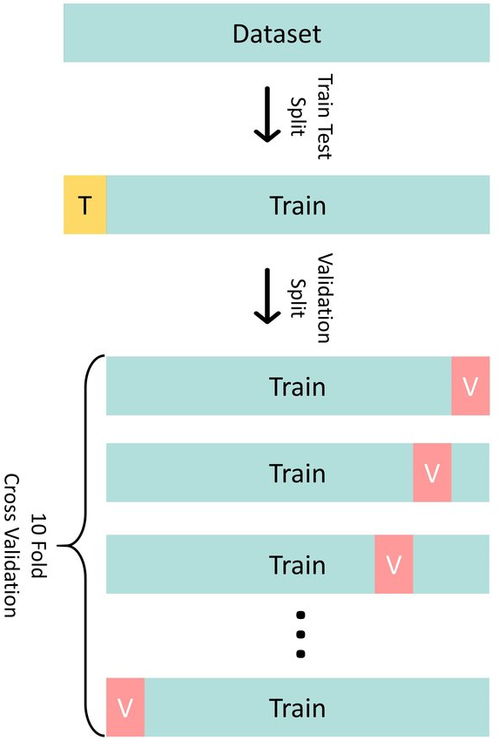
Validate my Validation!
With neural networks we use/refer to the validation set more.
The test set is held entirely aside, to evaluate performance.
This is the correct way to evaluate, tough usually should be similar.
Internally, the model uses the training data:
Split for cross validation similar to before.
We can specify that split, 20% is a reasonable start.
Small validation sets can lead to ’jumpy’ results.
As data gets bigger, percent needed for val/test shrinks.
We generally look to the validation whilst training.

Slide 29
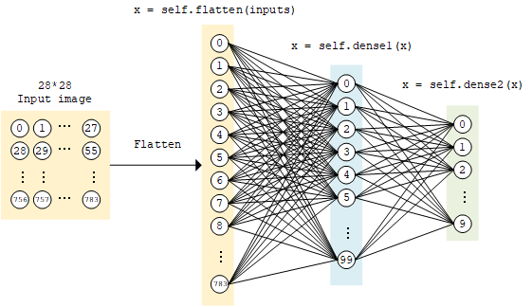
Add Layers

Slide 30
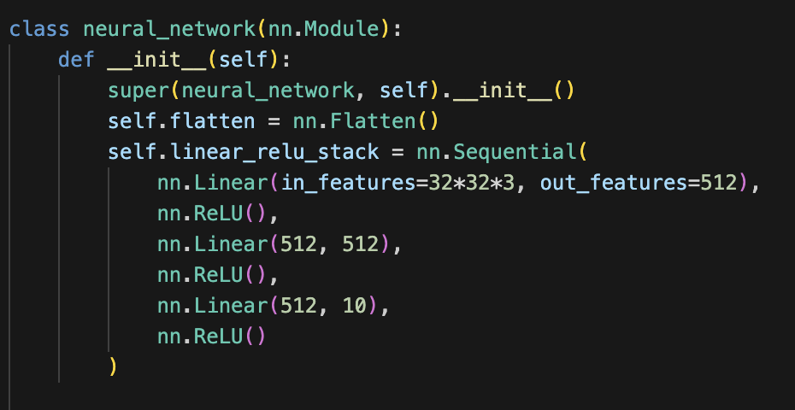
Adding and Connecting Layers
We construct the model by adding layers in order*.
This step create the layers.
There are many layer types, each an object in the library.
Generally, specify things like number of neurons as arguments.
‘Normal’ dense layers, activation layers, tuning ones like normalization, special types for image, time series, etc…
PyTorch will handle the connections and math automatically, we just add the layers.

Slide 31
Assorted Layers
There are many other layer types, we’ll look at some later.
There are different types of ’main’ layers for different model types.
E.g. layers that deal with data in 2D directly without flattening.
There’s layers for prep stuff – encode, normalize, etc…
There’s layers for tuning stuff – dropouts, regularization….
There’s models for activation functions.
You can make custom ones, if you want to.
We won’t really do this, but as long as your layer accepts/returns the right structure, it works.

Slide 32
Layers, For Now
Adding layers is one of the biggest things we can do to tune.
For now, don’t worry too much:
We need some first layer that can deal with the input shape.
May be something like flatten, or a regular layer with the size set.
We need an output layer that generates the predictions we want.
In between, we have hidden layers, where the magic happens.
A basic regression is 0 hidden layers, can’t do non-linear relationships.
Each layer adds “flexibility” in the relationships the model can handle.

Slide 33
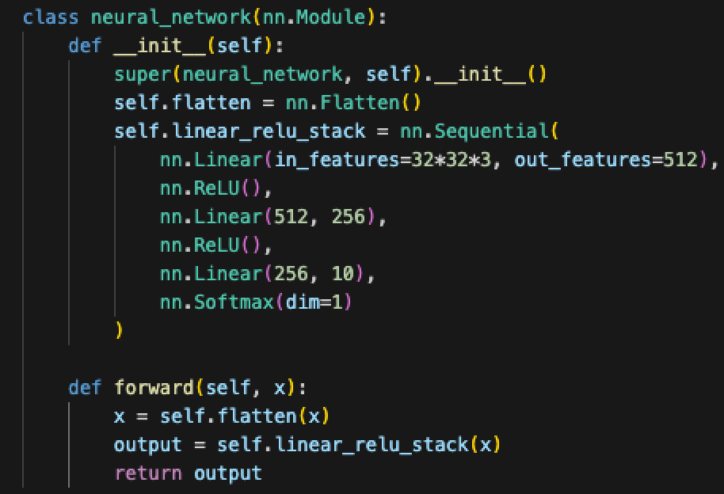
Make a pass at a Model
We also need to define the forward pass.
Start with an input.
Pass that input through the entire model.
Capture the prediction (output) at the end.
In practice, this is just using the layers we made.
For us, this is simple, it isn’t always in other cases.
We use fully connected layers.
Other models can have different structure.
Layers can be skipped, looped, etc…
Pytorch will figure out the backwards pass.

Slide 34
Input Layer(s)
The initial layer of a neural network needs to ‘handle’ the data’s shape.
Depending on scenario, this may involve reshaping.

Slide 35
Output Layer
The output layer translates from internal values to prediction.
Equivalent* to how a sigmoid translates logits to probability predictions.
Depending on what is being predicted, output layers vary.
Regression – none/linear.
Binary classification – sigmoid.
Multiway classification – softmax.
This is defined by the type of prediction, the model attached doesn’t matter.

Slide 37

Hidden Layers
Hidden layers are those between input and output.
We can have any number of hidden layers, a reasonable number to test is 1-5.
The number of neurons in the hidden layers is also very flexible:
Commonly see flat sizes until the output layer.
Also common to “funnel down” the sizes.
Exact setup is not deterministic, we’ll look at it more next week.
We’ll usually use “relu” for activation, we’ll look at these more later as well.
Reasonable approaches:
Set # of neurons for all layers to input size. Start with 1 hidden layer, add until overfit.
Lean towards a larger model and use regularization techniques and early stopping.

Slide 38
Go Deep!
The term deep learning refers to the number of layers.
Each layer effectively sees a different representation of data.
Each of those representations is learned, according to what helps most.
In unstructured problems (image, voice, NLP, etc…) this works very well.
Something like facial recognition is not the simplest problem.
Some layers may ‘capture’ head shape, some may ‘capture’ facial feature position, etc…
Classical ML -> features have direct-ish relationship to target.
Deep NN -> features (can) have complex relationship to target. (Combinations of features, combinations of transformations, combinations of different levels…)
It is kind of similar (concept, not math) to a repeated series of PCAs, it keeps trying to extract the ‘information’ each time the data goes through a layer.

Slide 39
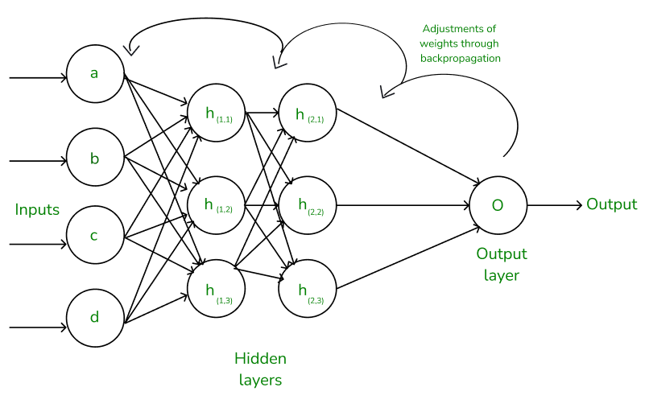
HoW models Learn
The neural network is complex if we examine the math, but the idea is simpler.
Think about it backwards, from the output layer back to the inputs.
The output layer generates predictions, which gives error.
Backpropagation effectively says, “the error here comes from these nodes, adjust bad ones”.
This is the gradient bit, error is attributed to terms and the weights are adjusted to get better.
The output layer ‘teaches’ the previous layer what it needs to be accurate.
This process repeats layer by layer – what does it need to have a more accurate output.

Slide 41
How Models Learn
Each layer is a different ‘view’ on the data, it gets transformed as it goes through.
At each layer, the useful stuff is kept, the useless stuff is ditched.
This is the weight adjustment part.
Parts of the model that pass data that results in errors gets changed.
Parts of the model that pass low-error stuff get kept as is.
The model (kinda) selects info from each representation (layer) to make a final prediction.
Terms with little error don’t get adjusted in the backpropagation.
This makes them so good at things like images – relationships that are complex can be captured.
The parts aren’t independent, so each change will impact other parts.

Slide 42
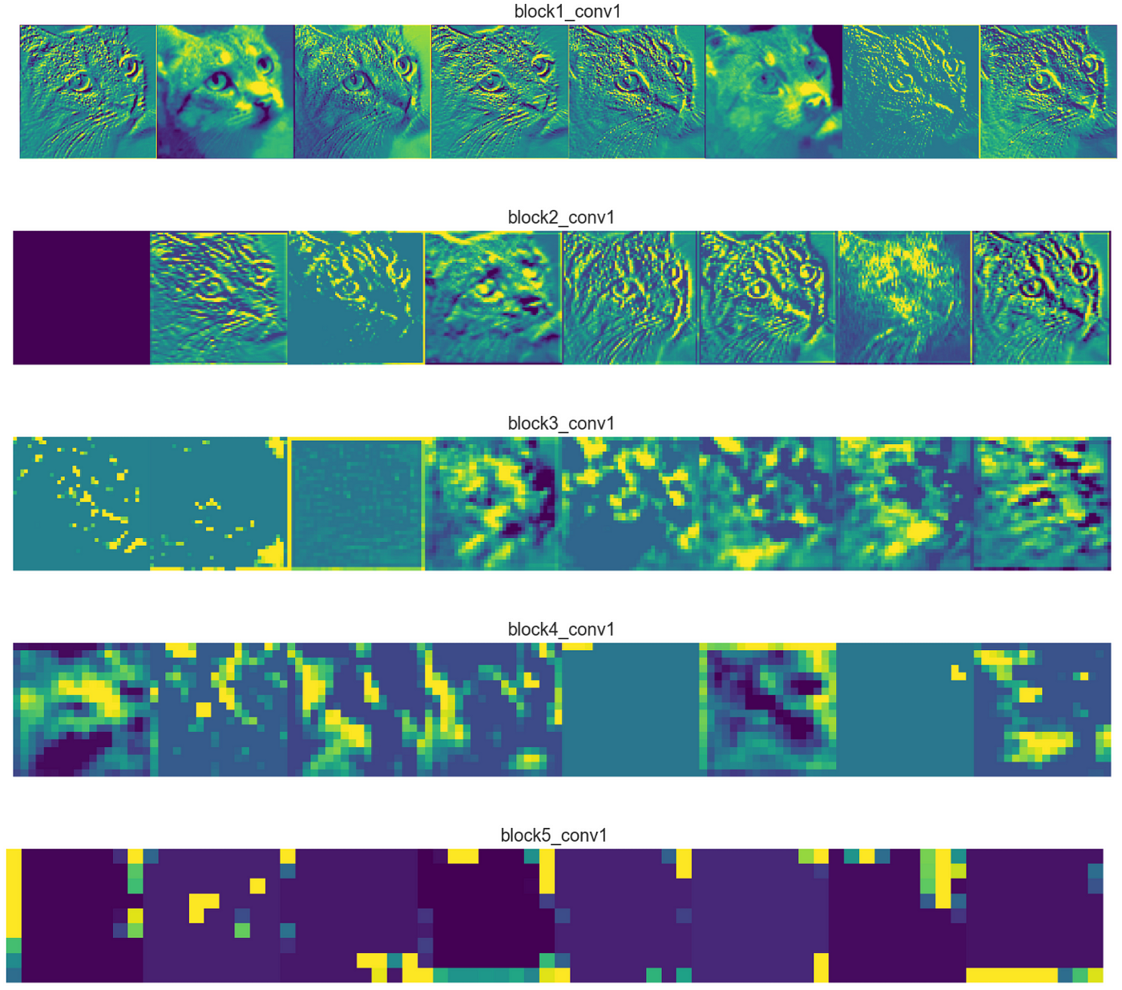
Why Hide your Layers?
Hidden layers allow (with activation) models to be adaptable.
A 0 hidden layer network is a logistic regression – linear only!
Adding hidden layers allows the model to ‘see’ different representations of the data.
Input of each layer is a transformation of the previous layer’s input.
That transformation is discovered as the weights are learned.
Each layer becomes roughly “if we look at the data like this, what helps us predict?”
Deep (lots of hidden) models tend to perform best for unstructured data.
The layers allow for models to learn very complex relationships.

Slide 44
Batching
One of the things that we’ll pay more attention to is batch size.
In many applications batch size becomes critical to performance.
With large data, we are limited by how big of a batch fits in (gpu) memory.

Slide 45
Recall – Stochastic Batches
Remember the inner working of gradient descent.
We do a prediction (forward pass) with all the data, tabulate error, then adjust weights.
The weights are adjusted once per batch. In ‘regular’ GD, batch = all data.
In neural networks “all the data” can be very large.
We often limit batches, for several reasons.
We may not be able to fit the data in (GPU) memory at all. E.g. with images.
Time to run one epoch may be super large. (Possibly days or weeks).
The batch size is one of the settings we need to consider in neural networks:
In larger cases it will be constrained by physical limits of the system like RAM.
For performance, things vary, but smaller batches empirically trend better (as of a few years ago).

Slide 46
Training and Testing Loops
We need to define the loop that will train (and test) our model.
The loop is largely boilerplate, walking the model through the steps:
Batch data, make predictions, get loss.
In testing – batch data, make predictions, calculate error.
We can define whatever monitoring we want or need.
Print results periodically in training/testing.
Send results to logging/monitoring location (later).
This part is kind of dumb, I think we should have a simple “fit()” option.
This ‘write a loop’ approach does allow you to log/report custom stuff more easily.

Slide 47
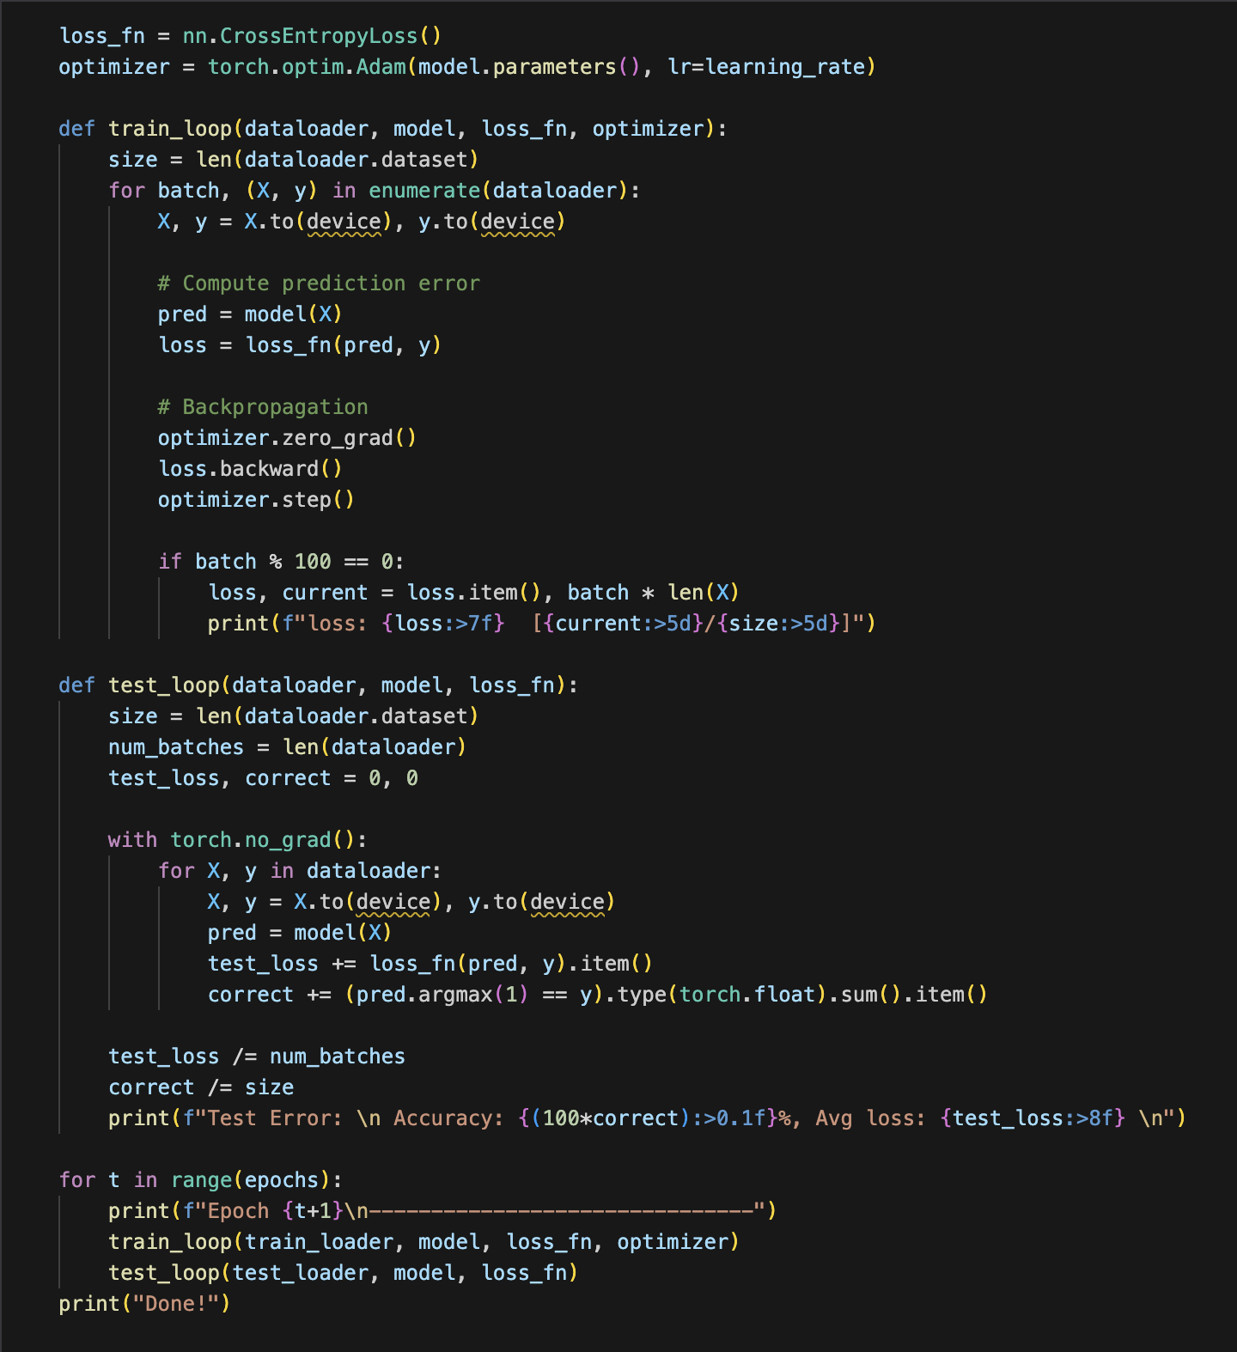
Simple Loops
This is a simple set of loops.
Most of this can be copy/pasted with only a few adaptations for us.
Read through it, and try to make sense of it step by step….
The test function just measures loss.
No_grad means it won’t do g.d.

Slide 48
Tuning Neural Networks
Tuning a neural network is more variable than a statistical model.
There are many interconnected things to change:
Structure – depth, width, layer types.
Regularization, normalization, other stuff like dropouts.
GD related – optimizer, batches, learning rate, etc…
Models can ‘learn around’ lots of settings and changes.
If we have enough data and enough model capacity, results will tend to converge.
Models are always adjusting to lower loss, lots of models can deliver similar results.
Trials can be a substantial cost – potentially literally.
Estimates of new LLMs are that they may take up to $1billion to train – trial runs are out!

Slide 49
Fighting Fit
Some techniques we can use to improve fit in a model are:
Regularization – we can enable L2/L1 regularization in layers.
Dropout – remove nodes on the fly. Similar in concept to bootstrapping in forests – parts of the model are removed each batch, preventing them from having excess influence. It forces the other parts of the model to learn.
Early stopping – stop the model’s training before it overfits. Also makes our lives easier, since our model will stop when done, even if we’re out at the club.
For now, make it 1-3 or so hidden layers, add regularization, use early stopping.
We’ll do more tuning soon, just ballpark it for now.
Neural networks will usually try to overfit everything, main concern is limiting that.

Slide 50
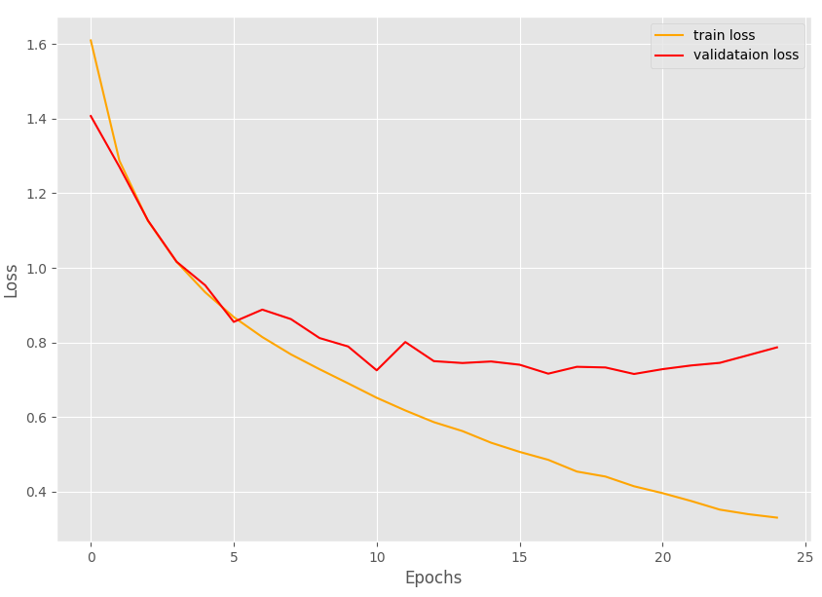
Verbosity and Outputs
We control the train/test loops, so we can define the output we want.
Normally want train/test loss printout every epoch or N epochs (if many).
Post training, we look at a training/validation loss plot.
We can use the loss plot as the main initial tool to tune our models.
Want the point where validation loss is minimized.
Gap between lines is roughly the amount of overfit – reduce with regularization/less capacity.
Similar lines indicate we can probably add more capacity.
If things are still improving, keep training.
This is highly variable, performance literally may vary model to model (esp. w/ small data).

Slide 51
Us verses Reality
In our usage we’ll use notebooks, look at the output, and do interactive stuff.
The notebooks are for exploration and learning, they aren’t really infrastructure grade.
This doesn’t really matter to us, but I always found CS gave us little context to the theory….
In ‘real’ usage, we wouldn’t use the notebooks, we’d have a regular program.
We’d probably experiment on a notebook, decide an approach, then run that for real.
May be a desire to rewrite some in other language, but most time is inside optimized torch stuff.
It should usually be pretty easy to extract our code to a .py file we could run.
Some planning can make it very easy (manage output, wrap code into functions, parameterize, etc…).
Run the training, save the output logs, save weights/models. Another file/api to predict, etc…
This would be combined with some infrastructure code – grab data, schedule, feed prediction data…

Slide 52

Lightning
There’s a higher level wrapper for PyTorch called Lightning.
It basically simplifies/condenses some things and reduces boilerplate code.
It also aims to make things more modular and things like distributed training easier.
Many people use it, potentially with other tools, to make trials/tests more efficient.
It isn’t that different from standard pytorch, and it is pretty common.
Be aware if you’re looking at examples online to avoid confusion.
We may touch on it later, depending on time and how you all feel.
Note: Keras can also use pytorch to some degree, this is part of the mess mentioned.

Slide 53
Using Pytorch
Overall, using pytorch models isn’t conceptually different, just more manual.
Instead of loading a model object with HP we must create it.
Instead of simple dataframe data manipulation, we need to make datasets.
Instead of fit(), we need to define the training process.

Slide 54
Using Pytorch
Pytorch is not the most user-friendly interface to start with.
There’s boilerplate code, lots of stuff is manual/custom, we are ‘in the weeds’, etc…
It does get much easier once you are comfortable with the theory.
Figuring out how NN work while figuring out the code is more challenging at first.
Print statements, example records, shapes, and counts are useful tools.

Slide 55
Conclusion
At a high level, pytorch models are used just like any other model.
In practice, most of the details of those parts are changed a bit.
Data: from dataframe to data loader.
Preprocessing: from pipeline to transformations.
Model: from new object to defining new class.
Hyperparameters: from arguments to ‘separate arguments’.
Training: from fit() to a custom loop that fits.
This takes a bit of practice to get used to, try a few as needed.
Q+A and troubleshooting become much, much easier with a little familiarity.
Play with structure, layers, options, and observe – we’ll worry about tuning later, experiment.

Slide 56

Creating a Tensorflow Model

Slide 57
Constructing a Tensorflow Model
To construct a tensorflow model we need to do a few more steps than with sklearn:
Create the model object itself.
Add layers (~ like a pipeline of steps, but including the ‘innards’ of the model).
Compile the model, specifying loss calculation info and what metrics to track.
Fit (train) the model.
Check the training/testing accuracy by epoch.
Note: some data preprocessing may be more easily done with a pipeline outside of model that only transforms. Especially since we are used to that, not so used to TF.
In real applications we can build custom layers to do some prep stuff – we won’t, just be aware.
We can also build some of the prep stuff into a dataset object, we’ll do this later.

Slide 59
Data Prep Pipes and Neural Nets
We can theoretically use/make a layer for most things that a pipeline does.
Encode, normalize, scale, etc…
Where and how this is actually done varies.
In simple examples, it is all over the place, often ad-hoc.
We can, later, create datasets that can manage large data and process steps.
These can handle large amounts of data easily – out of memory data.
We can plan for processing times to maximize resource utilization.
Tl;dr – we don’t care much about preprocessing details now, it’ll change with datasets.
You need to do it, just pick a spot – usually just before the modelling part.

Slide 60
Validate my Validation!
With neural networks we use the validation set more.
The test set is held entirely aside, to evaluate performance.
Internally, the model uses the training data:
Split for cross validation similar to before.
We can specify that split, 20% is a reasonable start.
Small validation sets can lead to ’jumpy’ results.
As data gets bigger, percent needed for val/test shrinks.
We generally look to the validation whilst training.

Slide 61
Add Layers

Slide 62
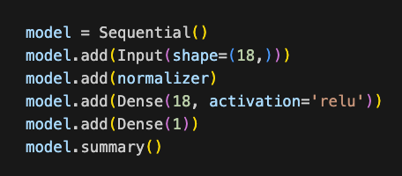
Layers
The most critical object for making our neural network is the layer.
We always have an input and output, and an arbitrary number of hidden.
TF has many types of layers:
Dense – the “standard” layer that is fully connected.
Preprocessing layers such as normalization.
Data manipulation layers such as flatten.
Activation layers (we don’t generally need these, we can tell the dense one to use activation).
Other weird ones we’ll look at next week or the week after.
In the first layer we need to specify the input shape.
In subsequent layers we just need to specify the output dimension (it auto-adapts the rest).
The connections between the layers (weights, bias, gradients) is handled for us.

Slide 63
Input Layer
One thing we saw when doing a neural network by hand was the attention required to the shape of the input data.
In tensorflow we can make this easier by using the input shape and flatten layers.
On the first layer of the network we can specify input_shape as a parameter:
This will ensure that the network “knows” the shape of the data.
This parameter is the shape of one record.
When we are using multidimensional data (for now) we can make the first layer flatten:
The flatten layer will take in the original shape and flatten it to 1 x whatever.
This allows us to avoid manual reshaping.

Slide 64
Tensors and Input Layer
Data can be in multiple dimensions.
The input layer defines the shape to expect.
For now, we’ll use something like (18,) which means just flat 18 features.
Later, like with images, we’ll specify the shape of each image, and the batch size in here.

Slide 65
Hidden Layers
We can have any number of hidden layers.
A reasonable number to test is 1-5.
The number of neurons in the hidden layers is also flexible:
Commonly see flat sizes until the output layer.
Also common to “filter down” the sizes.
Exact setup is not deterministic, we’ll look at it more next week.
We’ll usually use “relu” for activation, we’ll look at these more later as well.
Reasonable approaches:
Set # of neurons for all layers to input size. Start with 1 hidden layer, add until overfit.
Lean towards a larger model and use regularization techniques and early stopping.

Slide 66
Assorted Layers
There are many other layer types, we’ll look at some later.
There are different types of ’main’ layers for different model types.
E.g. layers that deal with data in 2D directly without flattening.
There’s layers for prep stuff – encode, normalize, etc…
There’s layers for tuning stuff – dropouts, regularization….
Many of these actions can be embedded in ’normal’ layers, or made separate.
We can embed regularization in a dense layer.
We can also add it as it’s own layer, for example, to do it as a separate step somewhere.

Slide 67
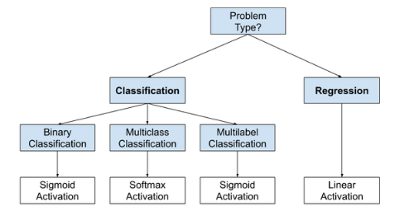
Output layer
The output layer is largely rules based depending on the output:
Binary classification: output size = 1, activation = sigmoid.
Multiclass classification: output size = # classes, activation = softmax.
Multilabel classification: output size = # classes, activation = sigmoid.
Regression: output size = 1, no/linear activation.

Slide 68
Compile
The compile step ”builds” the model from all the layers and other components.
We also specify loss info for the gradient descent:
Loss: What loss metric to use.
Optimizer: Which algorithm to use for the gradient descent.
Metrics: Which metrics to track (beyond loss). We can list any number, from train or validation.
Optimizer – we’ll use adam for the most part.
Different optimizers mostly seek for more efficient methods to converge. Adam is the current most popular and is pretty good in all respects. It is safe to just use this one.
This is more important in NN than regular GD– finding a solution can be slow, so this matters.
Metrics – we can specify a list of metrics for the algorithm to track.

Slide 69
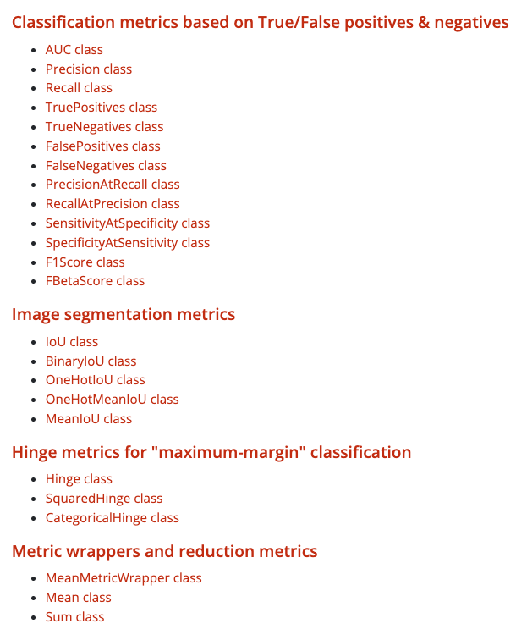
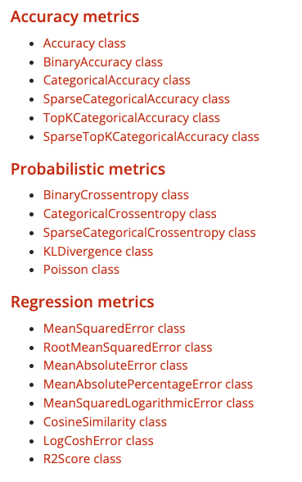
Metrics
We can tell the compile to track a set of metrics.
We can also make our own.
We can call them by the object name, or an informal name like “accuracy”.
We can also ask for a list with any number of metrics.

Slide 70
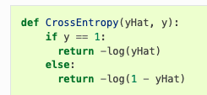
Loss
We can choose between many loss functions, they work just like in sklearn.
Regression:
MSE
MAE
Classification:
Binary cross-entropy
Categorical cross-entropy
Cross entropy is the general default. We’ll use this unless given a reason not to. We’ll look at other losses later on.
Note: these things are annoyingly named in tensorflow, some have several names.

Slide 71
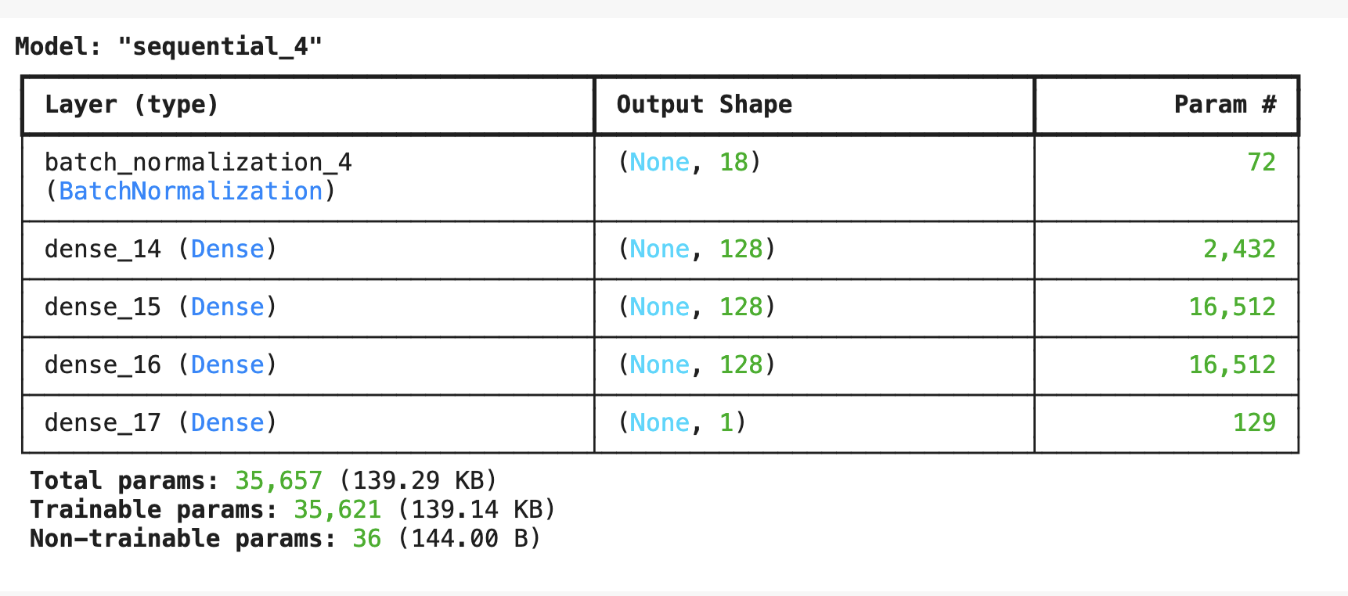
Summary
The summary gives us the structure of the model.
The shape shows us the dimensions of layers.
The first none is nothing, this is 1D data.
The Trainable Params are the total number of weights of the model – its capacity.
These weights are what gets trained. Can be GBs+.
If we have weights, we have ‘the model’.

Slide 72
Fit
The fit step trains the model once made and compiled with loss settings.
Epochs – number of rounds of training to execute.
We’ll look at early stopping, to stop when the model is best.
Batch size – how many records to process before updating weights.
Larger batch sizes generally complete faster.
Batch size is limited by hardware (memory) constraints.
Works just like in gradient descent – smaller is more “jumpy”
Rule of thumb for now – try 50 to 150ish. More later in tuning.
Needs to be grid searched for a true answer. Recommendations vary widely.
Validation – we can specify the share of data to run validation on.

Slide 73
Recall – Stochastic Batches
Remember the inner working of gradient descent.
We do a prediction (forward pass) with all the data, tabulate error, then adjust weights.
The weights are adjusted once per batch. In ‘regular’ GD, batch = all data.
In neural networks “all the data” can be very large.
We often limit batches, for several reasons.
We may not be able to fit the data in (GPU) memory at all. E.g. with images.
Time to run one epoch may be super large. (Possibly days or weeks).
The batch size is one of the settings we need to consider in neural networks:
In larger cases it will be constrained by physical limits of the system like RAM.
For performance, things vary, but smaller batches empirically trend better (as of a few years ago).

Slide 74
Callbacks
In the fit function, we can add a callback.
A callback is an action that happens at each batch/epoch end (normally).
We’ll deal with callbacks a bit more with tuning larger models.
Can be used for anything – such as saving progress, writing logs, generating outputs…
We usually use one for early stopping.
If the metric doesn’t improve, stop.
These callbacks can automate a lot of work and allow training to be unmonitored.

Slide 75
Model History
Tensorflow models also return a history that we can use to graph/examine.
We can build simple plotting functions to do this easily.
Generally want to look at training history:
Detect overfitting/underfitting with train/val loss.
See how many epochs are needed.
For larger/real examples, we can set the training to log progress to start/stop.

Slide 76
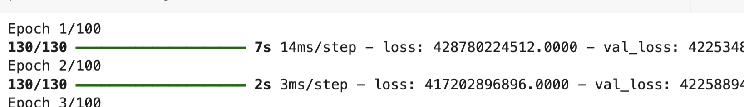
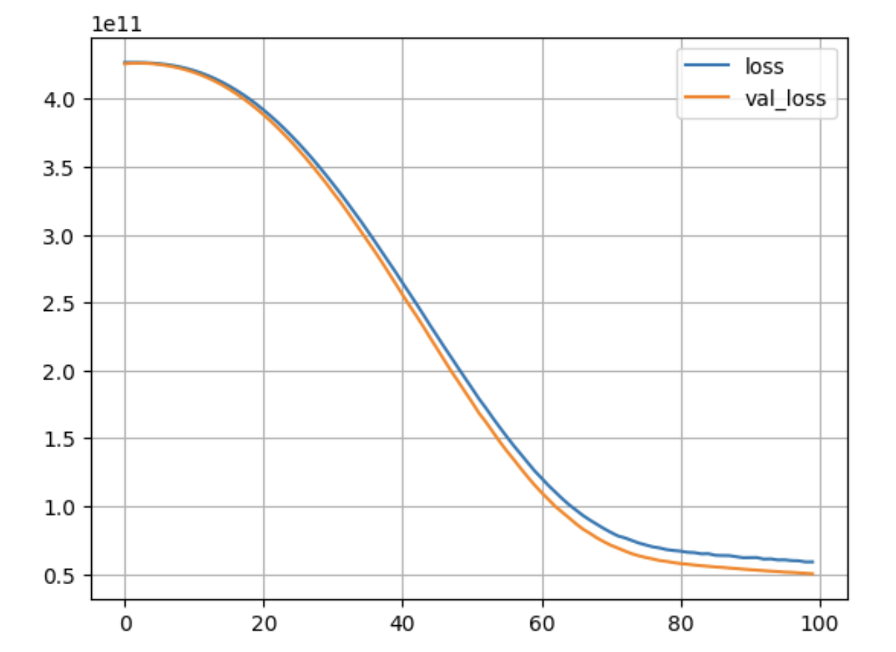
Verbosity and Outputs
The verbose parameter controls the feedback we get mid-training.
Training can take a while, so it can be nice to have some updates.
Metrics defined in compile get reported each epoch.
Post training, we look at a training/validation loss plot.
There’s a small function you can copy/paste to generate this from the history.
Think about the meanings of the diff. losses…

Slide 77
Making a decent Model
Tuning a neural network model is more complex than a sklearn stats model.
There are far more potential changes that can be made.
The performance is less predictable, and the changes are interdependent.

Slide 78
Fighting Fit
Some techniques we can use to improve fit in a model are:
Regularization – we can enable L2/L1 regularization in layers.
Dropout – remove nodes on the fly. Similar in concept to bootstrapping in forests – parts of the model are removed each batch, preventing them from having excess influence. It forces the other parts of the model to learn.
Early stopping – stop the model’s training before it overfits. Also makes our lives easier, since our model will stop when done.
For now, make it 1-3 or so hidden layers, add regularization, use early stopping.
We’ll do more of this next time.

Slide 79
Layer Flexibility Notes
Note that the layers we use have some (optional) stuff built into them.
Regularization.
Activation.
We can (but don’t usually) split these apart in some scenarios.
E.g. do normalization after regression by pre-activation.
This is mostly for context – we might see either in practice, they are interchangeable.

Slide 80
Keras Model Conclusion
Using keras based networks has a different process than the sklearn ones.
The process is largely the same, but the details of the steps differ quite a bit.
We need to create the structure of the model and build it first.
We can monitor more during/after the training process.
Performance of neural networks is very adaptable – they do their job well.
Highly complex models lead to more need for tuning work.
Model structure.
Details such as optimizer, activation, and learning rate.
Regularization and other fit techniques.

